Slide 1
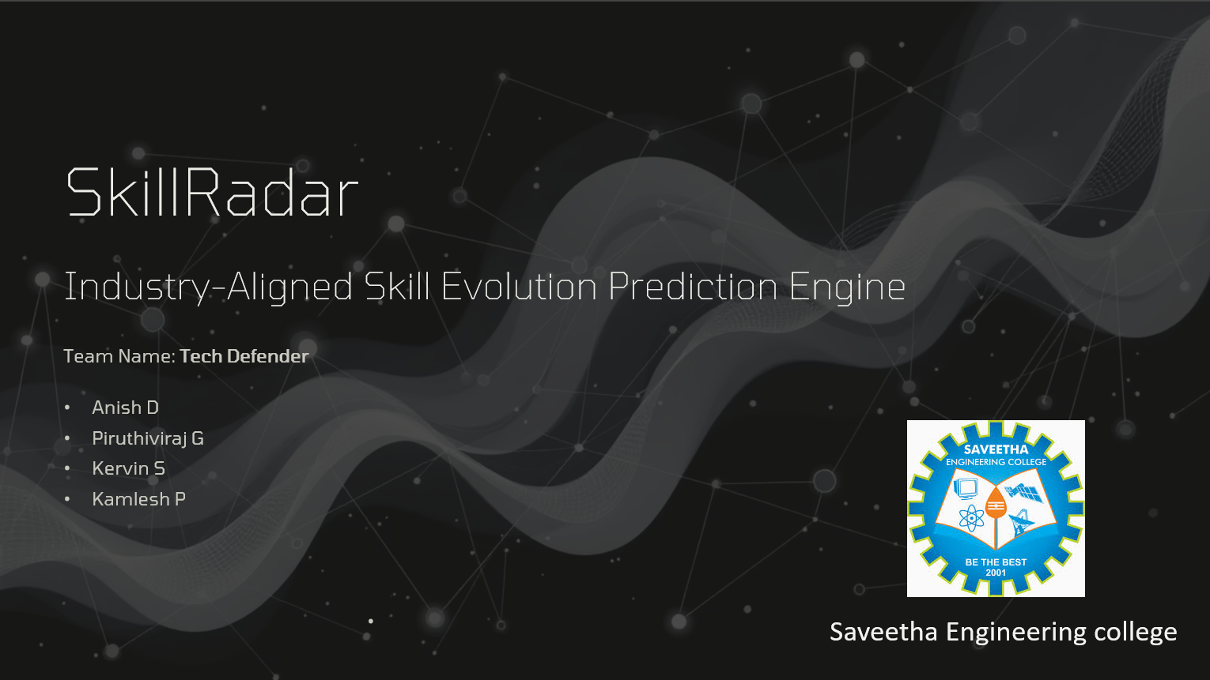
SkillRadar
AI-Powered Skill Prediction
Team: Tech Defender
Anish D
Piruthiviraj G
Kervin S
Kamlesh P

Slide 2

Introduction to SkillRadar
AI-powered gamified platform
Analyzes skills, market demands
Generates personalized learning paths
Transforms career progression

Slide 3

The Widening Skill Gap
Rapid Market Evolution
Market changes
Uncertainty in skills
Ineffective Learning
Wastes time
Lacks engagement
Fails individual needs
Economic Impact
Unemployment increase
Talent shortages
Hindering economic mobility

Slide 4

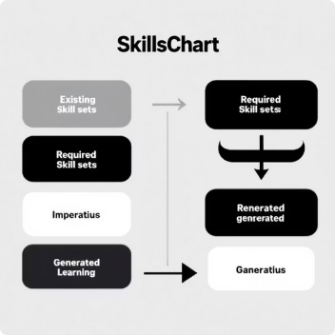


SkillRadar: Your AI Career Coach
SkillRadar: AI Career Coach.
Upload resumes, extract skills.
Personalized upskilling paths.
Automated Skill Extraction
Gap Analysis & Pathway Generation
Forecasting Engine
Gamified Validation
Predict high-demand skills.
Future market trends.
Validate skills with micro-assessments.
Earn XP, climb leaderboards.
Drag-and-drop resume parsing.
Identifies current competencies.
AI maps skills to roles.
Tailored learning journeys.

Slide 5
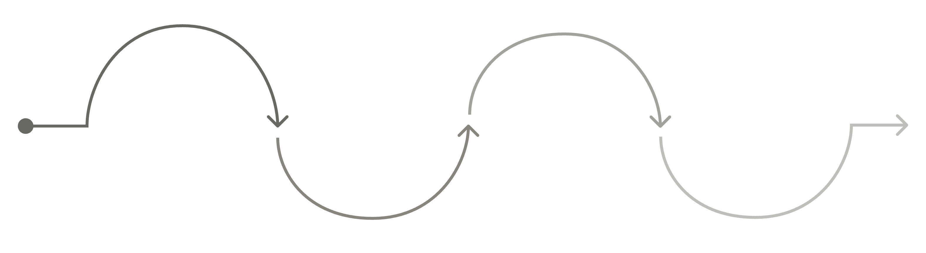
User Workflow: Journey to Mastery
Onboarding
Analysis
Action
Progression
Create account, upload resume
AI reviews skills, gaps
Personalized learning plan
Track growth, milestones
1
2
Onboarding
Analysis
Secure account, upload resume
NLP extracts skills, gaps
3
4
Action
Progression
Personalized plan, job matches
Micro-assessments, track growth

Slide 6

Robust Tech Stack
Programming Languages
Backend
FastAPI
SQLAlchemy (ORM)
Passlib/Bcrypt
PyJWT (Auth)
PyMuPDF (PDF)
spaCy (NLP)
Python
TypeScript/JS
HTML/CSS
Frontend
React (Vite)
Tailwind CSS
Lucide-React (Icons)
Recharts (Data Viz)
Packaging & DB
Pywebview (Desktop)
PyInstaller (Bundle)
SQLite (Local MVP)

Slide 7









System Architecture
Desktop GUI
FastAPI Backend
Processing Modules
SQLite Database
Responsive UI, Powerful Backend
Efficient Desktop Bundle
Ensures Data Privacy
Auth Module
NLP/Resume Service
Recommendation Engine
Gamification Engine
Secure User Registration
JWT, Password Hashing
Document Parsing
Extracts Key Entities
Processes Scores
XP, Leaderboard Management
Calculates Skill Gaps
Compares User Profiles

Slide 8

Innovation & Uniqueness
Bridging Gaps
Predictive Forecasting
Combines ATS, LMS, gamification.
Proactive career development.
Bridges skill gaps.
Innovative forecasting models.
Predicts future skill demands.
Keeps users future-ready.
Localized & Responsive
Scalable & Adaptable
Localized desktop app.
Low latency, high privacy.
Focused learning environment.
API-first design.
Seamless SaaS migration.
No backend rewrite needed.

Slide 9
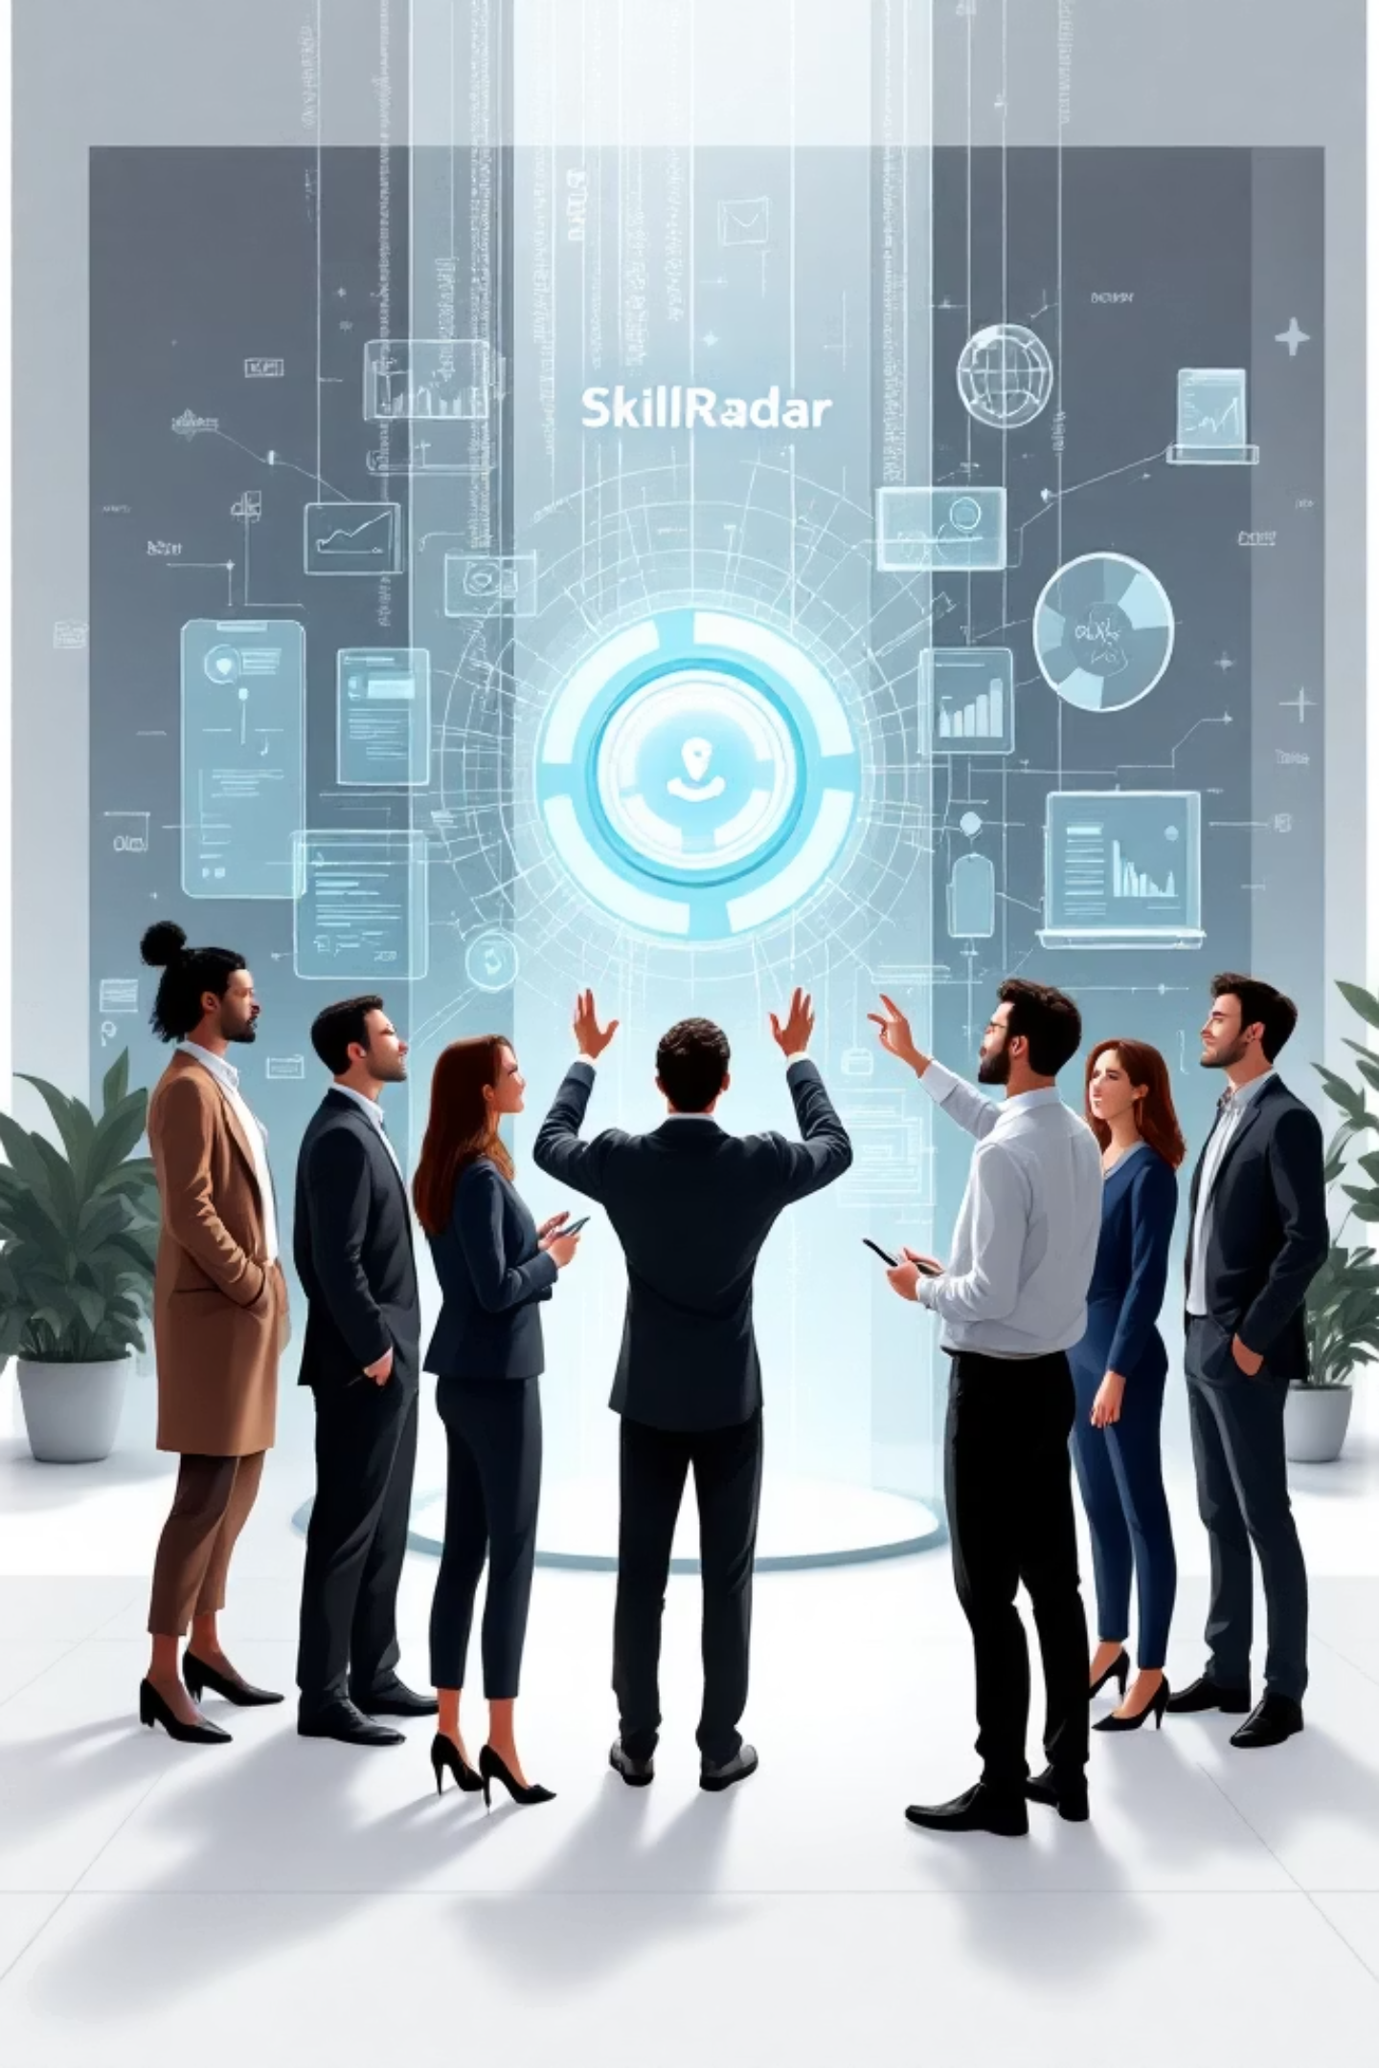
Conclusion & Future Vision
1
SkillRadar Overview
Gamified AI career platform
2
Expected Impact
Reduce time-to-hire
Align workforce with demands
3
Real-World Applicability
Universities, corporate L&D
Self-taught professionals
4
Future Enhancements
Integrate job board APIs
Implement LLMs
Add multiplayer features

